Slide 1
Names of your group members

Slide 2
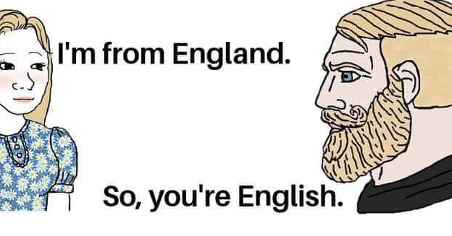
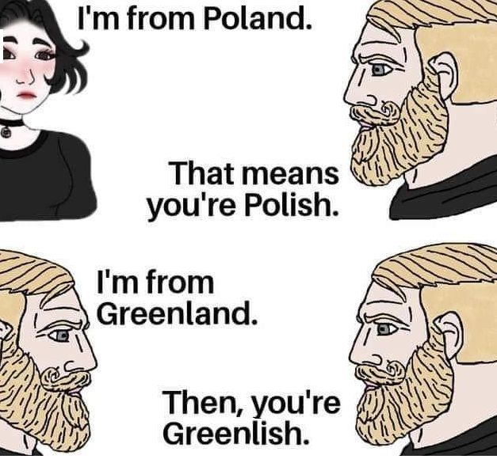
Task 2: Find the premise/conclusion indicators and the assumption
Premise/conclusion indicator: So
Assumption: I’m from England
Premise/conclusion indicator: That means
Assumption: I’m from Poland
Premise/conclusion indicator: Then
Assumption: I’m from Greenland.

